Slide 1
CHAPTER 7
The income statement:
Components and applications

Slide 2
Learning objectives
After reading this chapter, students should be able to do the following:
7.1 Explain the purpose of the income statement.
7.2 Understand the importance of measuring ﬁnancial performance.
7.3 Discuss the deﬁnition and classiﬁcation of revenue/income.
7.4 Discuss the deﬁnition and classiﬁcation of expenses.
7.5 Evaluate the performance of business using ratios.
7.6 Link outcomes from the income statement to owner’s equity and close the accounts.

Slide 3
Key questions
Why is a business’s income statement important?
How are changes in a business’s income statement accounts recorded in its accounting system?
What are the parts of a retail business’s classiﬁed income statement, and what do they contain?
What are inventory and cost of goods sold, and what inventory systems may be used by a business?
What are the main concerns of external decision makers when they use a business’s income statement to evaluate its performance?
What type of analysis is used by external decision makers to evaluate a business’s proﬁtability?
Why does a business close off its revenue and expense accounts at the end of each period?

Slide 4
7.1 Why the income statement is important
A business’s income statement plays a key role in the decision making
Net income = Revenues - Expenses
You may also hear the income statement referred to as a proﬁt and loss (or P&L) statement.

Slide 5
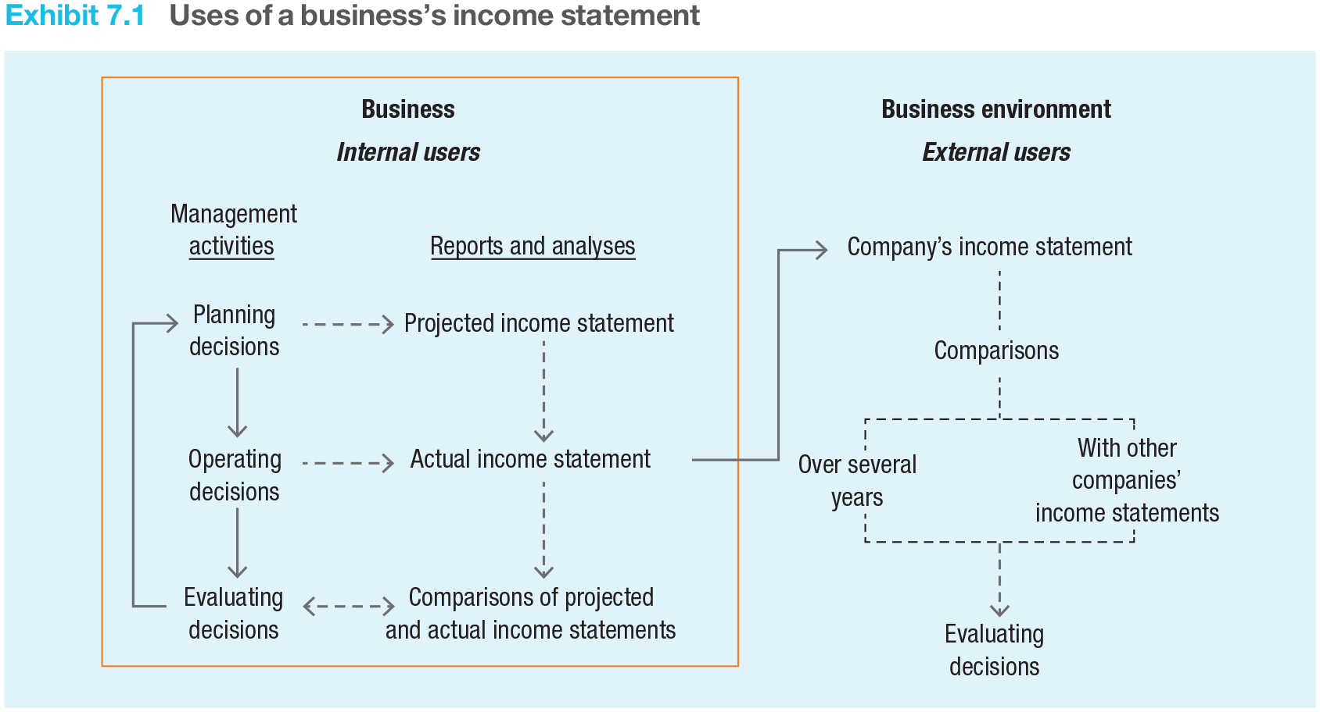
7.1 Why the income statement is important
Exhibit 7.1 Uses of a business’s income statement
The income statement summarises the results of a business’s operating activities for a speciﬁc accounting period.

Slide 6
7.1 Why the income statement is important
A supplier can compare its customers’ income statements to determine which customers might represent the best credit risks.
Generally accepted accounting principles (GAAP) (see Chapter 4) ensure that all businesses calculate and publish ﬁnancial statement information in a similar, and thus comparable, manner.
So understanding GAAP is important – to the accountant who prepares ﬁnancial statements and to the external decision maker who uses these statements to make business decisions.

Slide 7
7.2 Measuring financial performance: the income statement
The income statement is an important part of the decision-making process for both internal and external users.
Net income = Revenues – Expenses
Revenues may be thought of as the ‘accomplishments’ of a business during an accounting period.
The classiﬁed income statement of a retail business like Café Revive presents details of all income matched against expenses to determine Profit or Loss.

Slide 8
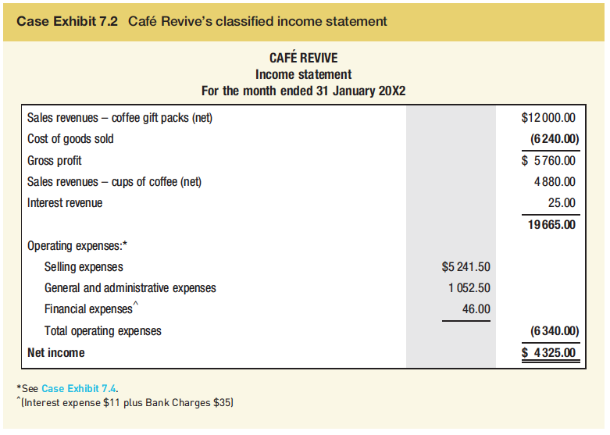
7.2 Measuring financial performance: the income statement

Slide 9
7.2 Measuring financial performance: the income statement
The ‘Other items’ (sometimes called the non-operating income) section of a business’s income statement includes items that are not related to the primary operations of the business.
This section reports revenues and expenses related to investing activities or to ﬁnancing the business’s operations (e.g. interest revenue and interest expense), revenues and expenses (called gains and losses) related to selling property and equipment assets, and incidental revenues and expenses (e.g. miscellaneous rent revenue and losses due to theft or ﬁre).

Slide 10
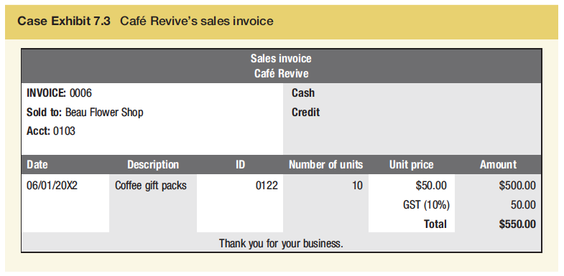
7.3 Defining and classifying revenues/income
Sales revenue
Whether a customer buys goods for cash or on credit, retail businesses use a ‘Sales revenue’ (or ‘Sales’) account to record the transaction.
Emily records the 6 January credit sale by ﬁrst increasing ‘Accounts receivable’ by $550 to show that Beau Flower Shop owes Café Revive that amount.

Slide 11
7.3 Defining and classifying revenues/income
There are three types of sales policies:
discount policies,
sales return policies and;
sales allowance policies.
Discounts
quantity (or trade) discount,
sales discount,
cash discount.
Sales (cash) discount terms might read, for example, ‘5/7, n/31’ (i.e. ‘ﬁve seven, net 31’). If Café Revive makes a $66 sale on credit with the terms 5/7, n/31 and the customer pays the invoice within seven days, the customer would pay $62.70 ($66 – [0.05 x $66]), and $3.30 would be the sales discount taken. On the worksheet:
Cash +$62.70, Accounts Receivable -$66 and Expenses $3.30 (-)

Slide 12
7.3 Defining and classifying revenues/income
Sales returns and allowances
Jake McAdams pays cash for four coffee gift packs at $55 per box
Each gift pack has a base cost price of $26. Emily would record this transaction by increasing Café Revive’s ‘Cash’ account and ‘Sales revenue’ by $220 (4 x $55), decreasing ‘Inventory’ by $104 (4 x $26) and increasing ‘Cost of goods sold’ (an expense) by $104.
Return – if Jake returns one coffee gift pack
Sales Return – 55, Cash -55 (Refund) Inventory + 26, Cost of Goods Sold - $26 (- *- = +) .
Allowance What would happen if, when Jake opens the gift packs later that day, he notices that one of them is damaged? Business agrees on $5 allowance
Sales allowance -$5, Cash -$ 5 (refund)

Slide 13
7.3 Defining and classifying revenues/income
Net sales
Sales – Sales Returns – Sales Allowances = Net Sales
Revenue from other sources
  Commission, interest, gain on sales etc. Should appear after Gross Profit otherwise will distort the Gross Profit %

Slide 14
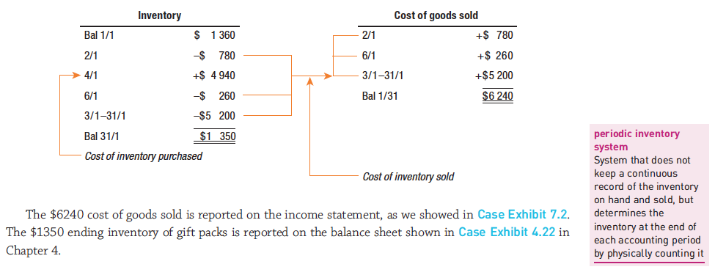
7.4 Defining and classifying expenses
Cost of goods sold – ‘You have to spend money on goods to make money’.
A perpetual inventory system keeps a continuous record of the cost of inventory on hand and the cost of inventory sold.

Slide 15
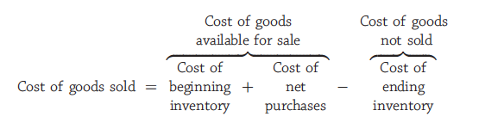
7.4 Defining and classifying expenses
(Periodic Inventory System)
When the business does not record the cost of the goods sold when each sales transaction takes place, it must calculate its cost of goods sold for an accounting period.
The physical inventory is counted and then each item is values to arrive at a dollar figure for cost of ending inventory

Slide 16
Measuring Inventory
Whether the perpetual method or the periodic method is used, the inventory which appears in the financial statements should follow the rule should be valued
“Inventory shall be measured at the lower of cost and net realisable value”. NZIAS 2
Net realisable value (NRV) is determined as “the estimated selling price in the ordinary course of business less the estimated costs of completion and the estimated costs necessary to make the sale” NZIAS 2

Slide 17
7.4 Defining and classifying expenses
The term net purchases is used because the amount of merchandise purchases (invoice cost and transportation-in) is adjusted (reduced) for purchases returns, allowances and discounts.
The business receives returns and allowances as well as giving them
A business’s cost of ending inventory is the dollar amount of merchandise on hand, based on a physical count at the end of the accounting period.

Slide 18
7.4 Defining and classifying expenses
Gross proﬁt is the amount of revenue that a business has ‘left over’ (after recovering the cost of the products it sold) to cover its operating expenses.
Café Revive subtracts its $6,240 cost of goods sold for coffee gift packs from its $12,000 sales revenue (net) for coffee gift packs to get its $5,760 gross proﬁt, as we showed in Case Exhibit 7.2.
Operating expenses are the expenses (other than cost of goods sold) that a business incurs in its day-to-day operations.

Slide 19
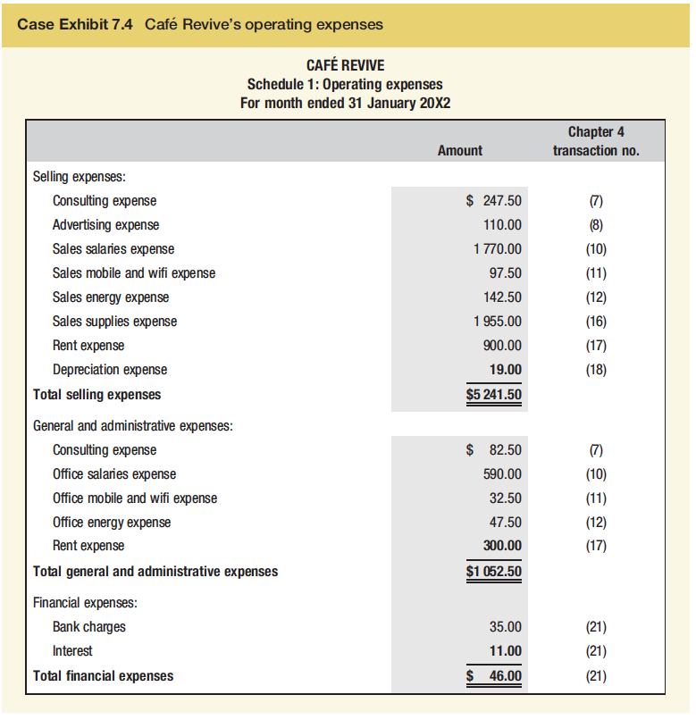
7.4 Defining and classifying expenses
Note. It is not mandatory that a business classify its operating expenses in any particular way. This is a simple method of classification given by many textbooks

Slide 20
7.5 Evaluating the income statement using ratios
Accounting information helps managers plan, operate and evaluate business activities.
Managers use accounting information on a day-to-day basis to help them make decisions.
If you are a creditor, a business’s ﬁnancial statements help you decide whether to loan money to the business and, if so, under what loan arrangements.
Investors use the income statement to help judge their return on investment and creditors use it to help make loan decisions.
Financial statement users evaluate a business’s risk, operating capability and ﬁnancial ﬂexibility.

Slide 21
7.5 Evaluating the income statement using ratios
Ratios - Ratio analysis consists of calculations in which an item on the business’s ﬁnancial statements is divided by another related item.
Profit margin = Net income/Net sales
=4325/16880 = 25.62%
This means that, on average, 25.62 cents of every sales dollar is proﬁt (net income) for Café Revive based on Case Exhibit 7.2.
Gross proﬁt percentage = Gross profits/Net sales
= 5760 /12000 = 48%
On average, 48 cents of every sales dollar (after the cost of goods sold is subtracted) is left to cover operating expenses and other expenses and to increase Café Revive’s net income.

Slide 22
Gross Profit percentage
= Gross Profit / Net Sales
What proportion of sales is left to cover overheads and provide a profit?
How does it compare with previous years and / or similar businesses?
A minor change in the GP % can have a large impact on net profit
If a decrease in GP % creates higher sales then it might lead to a higher gross profit in dollar terms

Slide 23
7.5 Evaluating the income statement using ratios
Proﬁtability ratios of actual businesses
Ratios | Super retail group | Woolworths
Profit margin percentage | 4.94% | 3.15%
Gross profit percentage | 45.22% | 29.33%
Super Retail Group had a higher gross proﬁt percentage and a higher proﬁt margin percentage than Woolworths.
Based on a comparison of these ratios, we can say that Super Retail Group was more efﬁcient than Woolworths in controlling both the costs of merchandise and the costs of operating expenses.

Slide 24
7.5 Evaluating the income statement using ratios
Statement of comprehensive income
In addition to the income statement, the New Zealand International Accounting Standard - NZIAS 1 Presentation of Financial Statements requires that entities present a statement of comprehensive income, which is effectively the income statement plus all other comprehensive income.

Slide 25
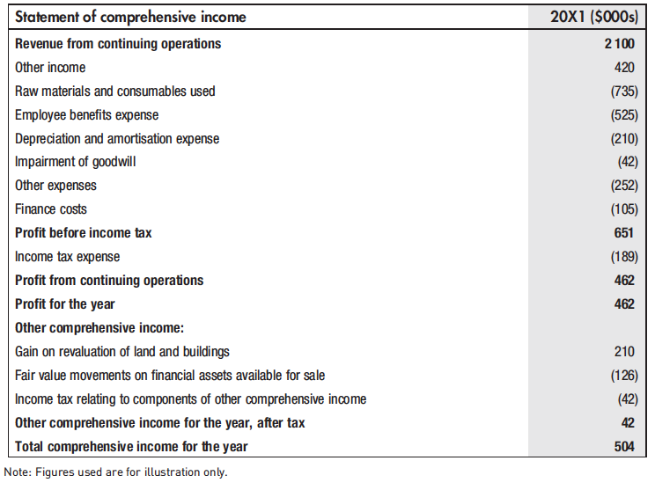
7.5 Evaluating the income statement using ratios
Example 1 Income statement and statement of comprehensive income in one statement
Entities can choose to present either:
a single income statement and statement of other comprehensive income
two statements

Slide 26
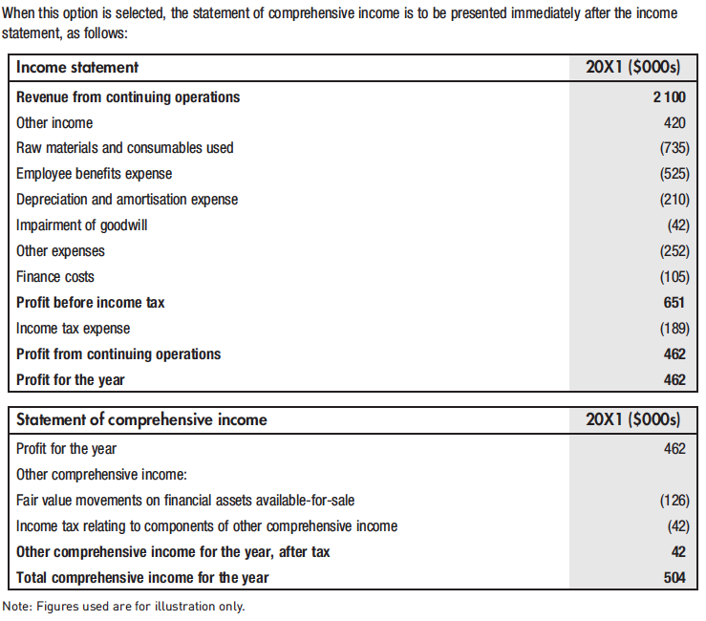
7.6 Linking profit to owner’s equity and closing the accounts
Example 2 Income statement and statement of comprehensive income in separate statements.

Slide 27
7.6 Linking profit to owner’s equity and closing the accounts
A business owner’s equity is affected by the owner’s investments and withdrawals, as well as by the business’s revenue and expense transactions.
Withdrawals are recorded as reductions of the owner’s capital account because they are disinvestments of assets by the owner.

Slide 28
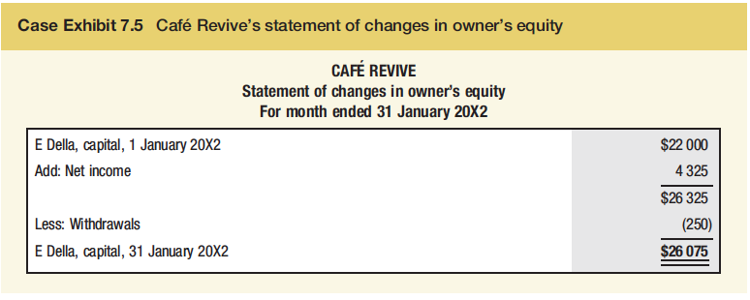
7.6 Linking profit to owner’s equity and closing the accounts
The $22 000 beginning amount of owner’s capital comes from the ‘E Della, capital’ account (shown in Case Exhibit 4.6 in Chapter 4). Emily made no additional investments during the accounting period, so the next item is net income. The $4325 net income comes from the income statement in Case Exhibit 7.2. The $250 of withdrawals comes from the ‘E Della, capital’ account in Café Revive’s accounting records. The $26 075 ending amount for ‘E Della, capital’ is the amount to be reported as owner’s equity.
Case Exhibit 7.5 Café Revive’s statement of changes in owner’s equity

Slide 29
7.6 Linking profit to owner’s equity and closing the accounts
A business uses closing entries so that when a new accounting period starts:
the revenue and expense accounts (temporary accounts) have zero balances, and no longer contain the amounts of any transactions from previous periods
the accounting system keeps the revenue and expense transactions of the current period separate from the revenue and expense transactions of other periods
the permanent (balance sheet) accounts are up-to-date (i.e. net income has been added to the previous balance of the owner’s capital account).
Making closing entries is not part of this course but it is good to be aware of them

Slide 30
7.6 Linking profit to owner’s equity and closing the accounts
Business issues and values
What is corporate social responsibility (CSR)?
Impact of casualization of labour
Environmental disasters can result in costs that have signiﬁcant impacts on business proﬁtability.

Slide 31
Key takeaways
Explain the purpose of the Income Statement in terms of financial performance.
Understand the terms Revenue and Expenses.
Be aware of ratios to evaluate performance.
Know how profits are transferred to owners accounts.
Understand the purpose of closing entries.

